Slide 1





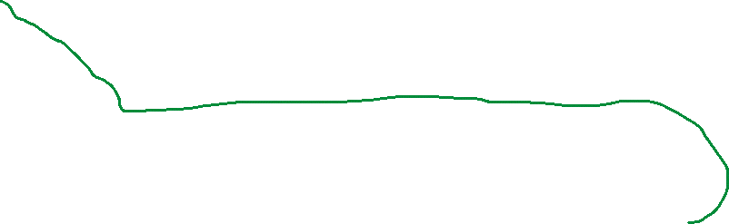




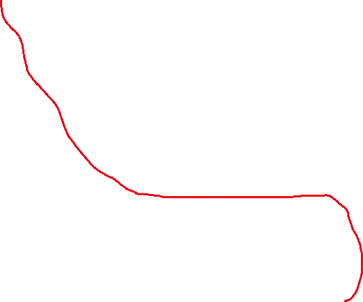



Date
Day | Month | Year | dateString
29 | 11 | 2001 | 29-11-2001
13 | 5 | 1992 | 13-5-1992
Login
uID | Email | Password
1 | alimohamedhassan9@outlook.com | Something
2 | rightiphone123@gmail.com | Anything
Order
rOrder | Food | Drink | Price | orderID | gOrder
3 | Pizza | Water | 2.15 | 5 | 4
null | Pasta | Juice | 4.00 | 6 | 4
Cashier
Name | bID | Email | Phone | Salary | Start | End | Position | Office | Task | Password | kDOB
Ali Mohamed Ali | 3 | alimohamedhassan9@gmail.com | +97339266642 | 75 | 8:30 | 22:30 | Salesclerk | Kitchen | Manage customer orders | Something | 29-11-2001
Customer
Name | cID | Email | Phone | Reservation | Password | mDOB
Josef Alex | 4 | rightiphone123@gmail.com | +97336225314 | Table 1 | Anything | 13-5-1992
User
Name | pID | Email | Phone | Password | rDOB
Ali Mohamed Ali | 3 | alimohamedhassan9@gmail.com | +97339266642 | Something | 29-11-2001
Josef Alex | 4 | rightiphone123@gmail.com | +97336225314 | Anything | 13-5-1992

